Slide 1
AVAGO LSI INNER LABEL SYSTEM USER GUIDE
CUSTOMER SEAGATE

Slide 2
Normal Flow (Successful Flow)

Slide 3
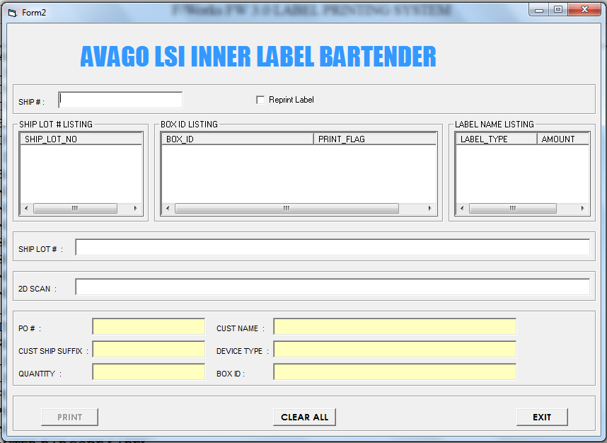
SYSTEM MAIN INTERFACE

Slide 4
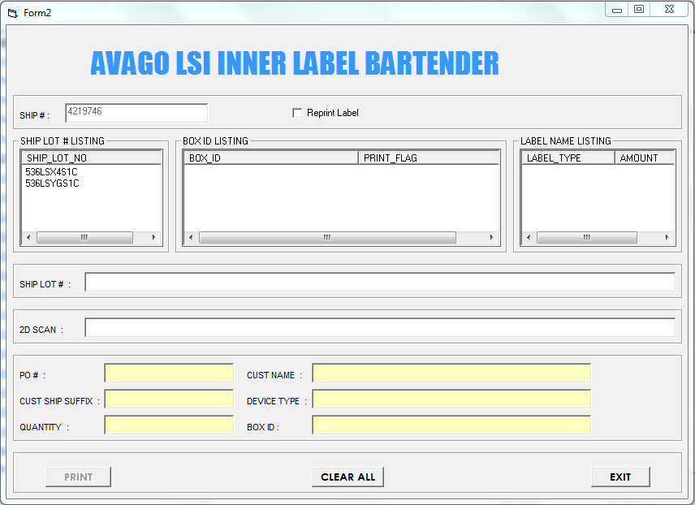
1. Insert Ship No.
Ship Lot No. Popup

Slide 5
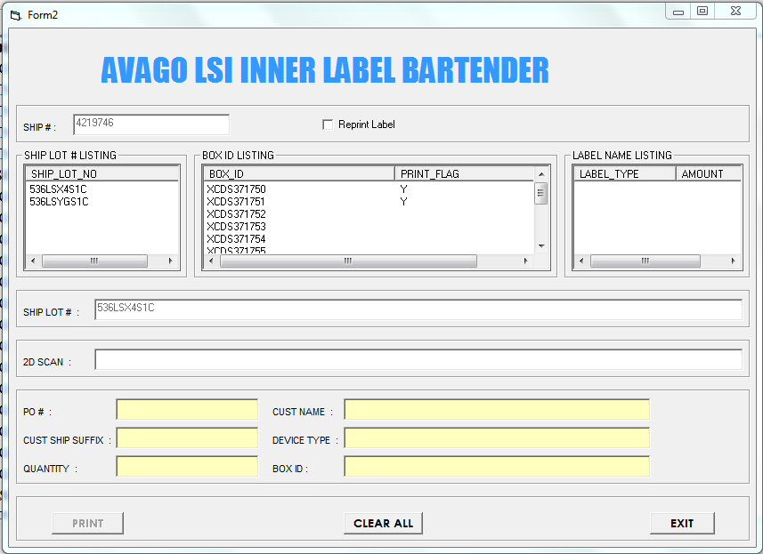
2. Insert Ship Lot No.
Box ID and Print Flag Popup

Slide 6
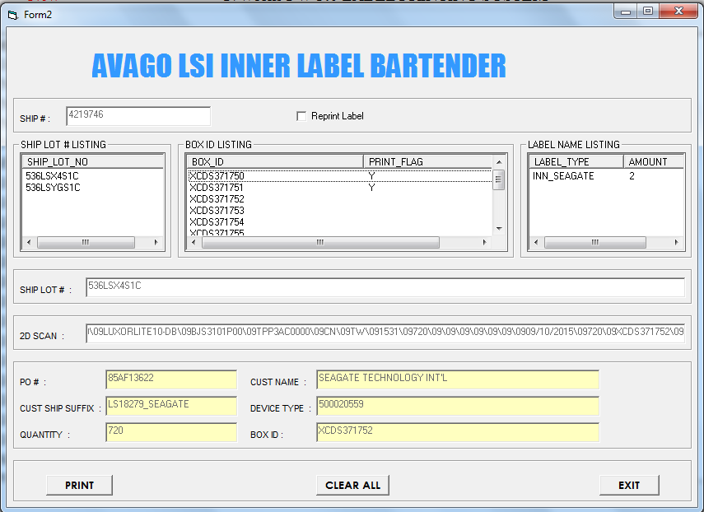
3. Insert 2D Barcode
Label Type and print amount popup
Print Function Enable

Slide 7
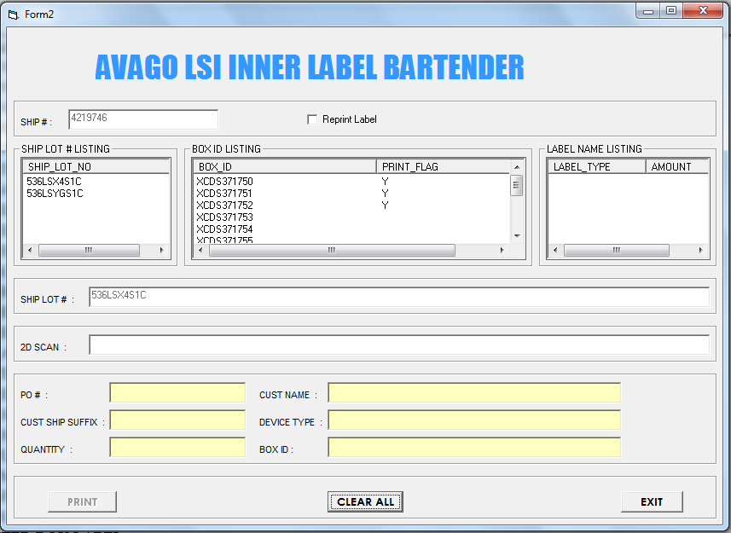
4. Print Label Successful
Print Flag Updated
2DBarcode Information Clear

Slide 8
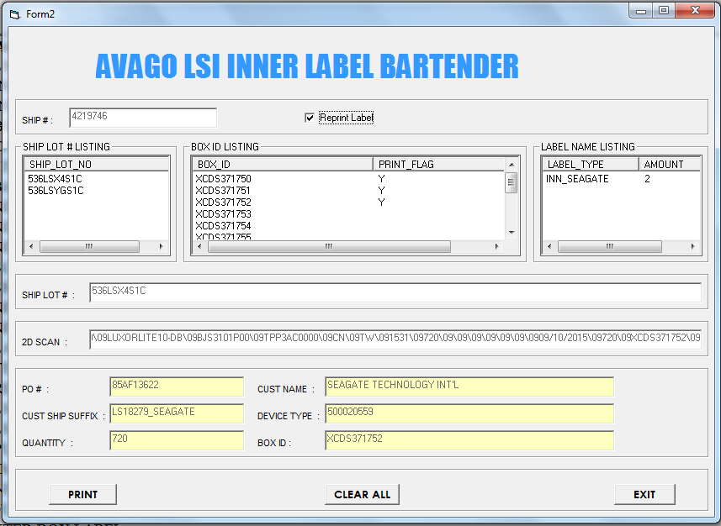
5. Reprint
Insert all information
Select Reprint Label Function
Select Print Function

Slide 9
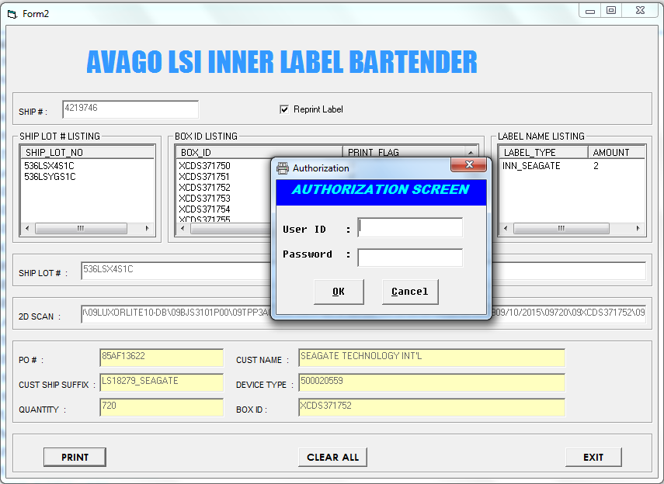
Enter authorize ID

Slide 10
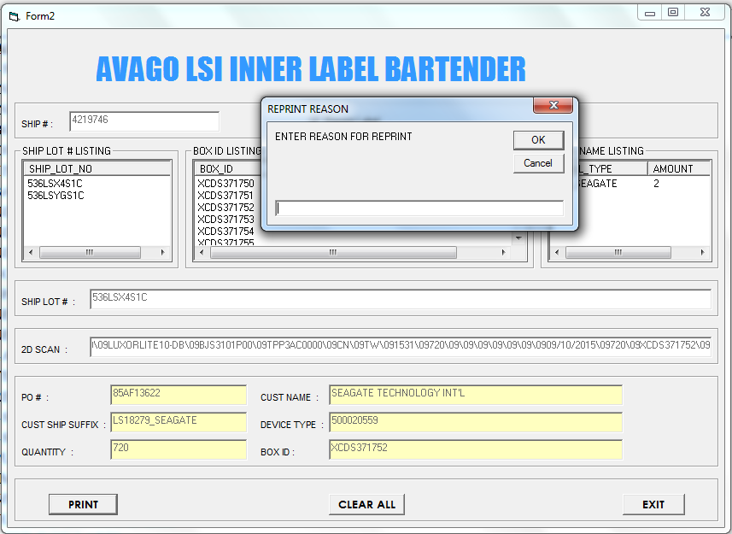
Enter reprint reason

Slide 11
6. Reprint Label Successful
2DBarcode Information Clear

Slide 12
Alternative Flow (Error Flow)

Slide 13
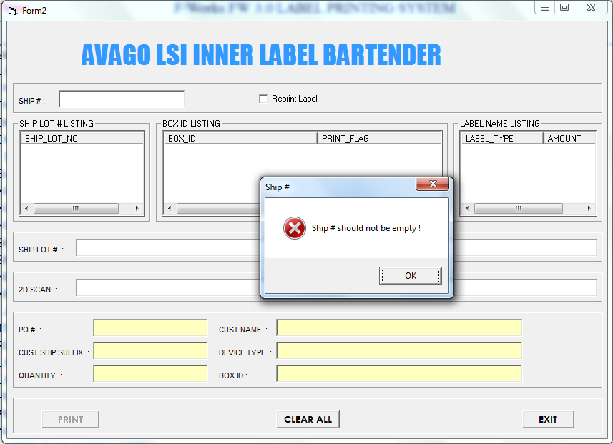
Ship No. Empty

Slide 14
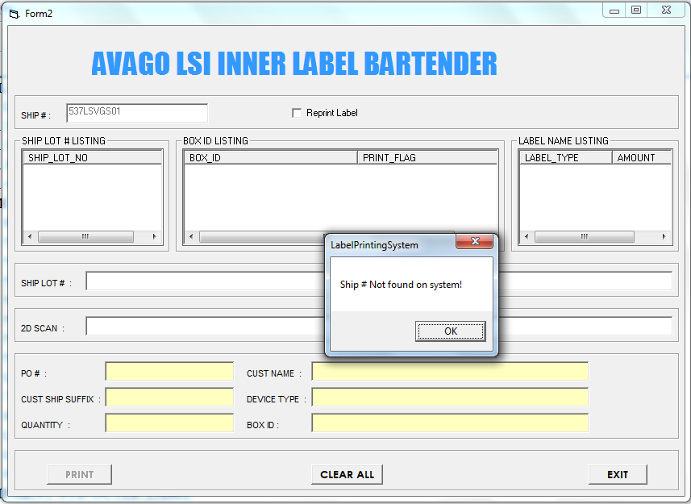
Ship No. Invalid

Slide 15
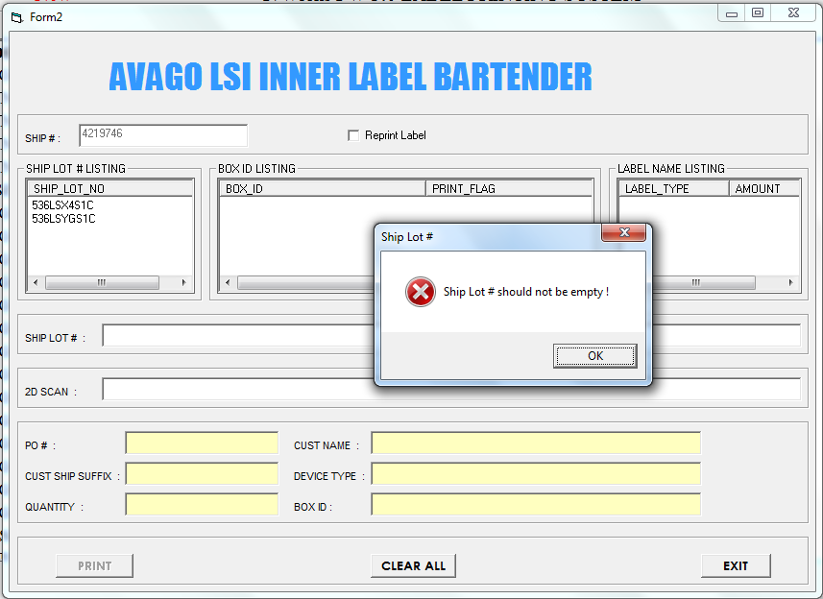
Ship Lot No. Empty

Slide 16
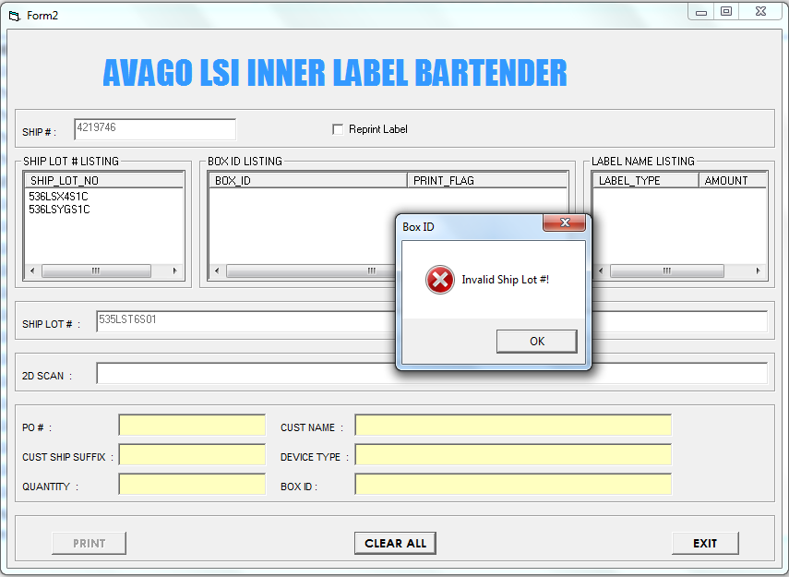
Ship Lot No. Invalid

Slide 17
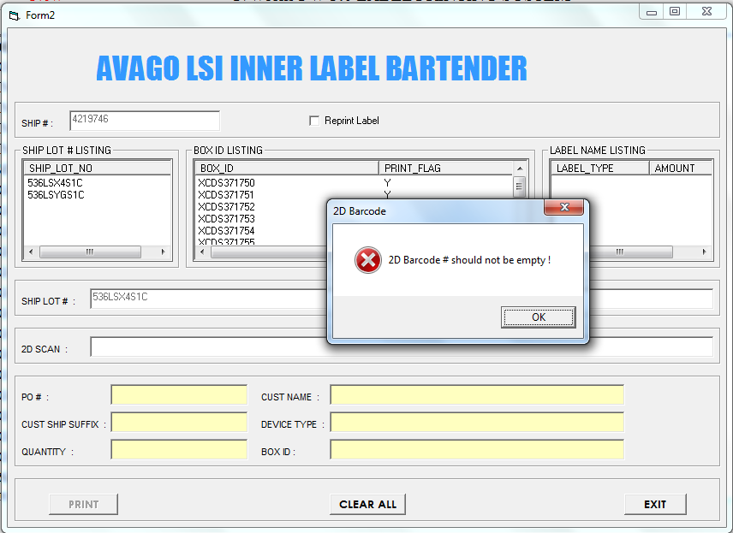
2D Barcode No./Scan Empty

Slide 18
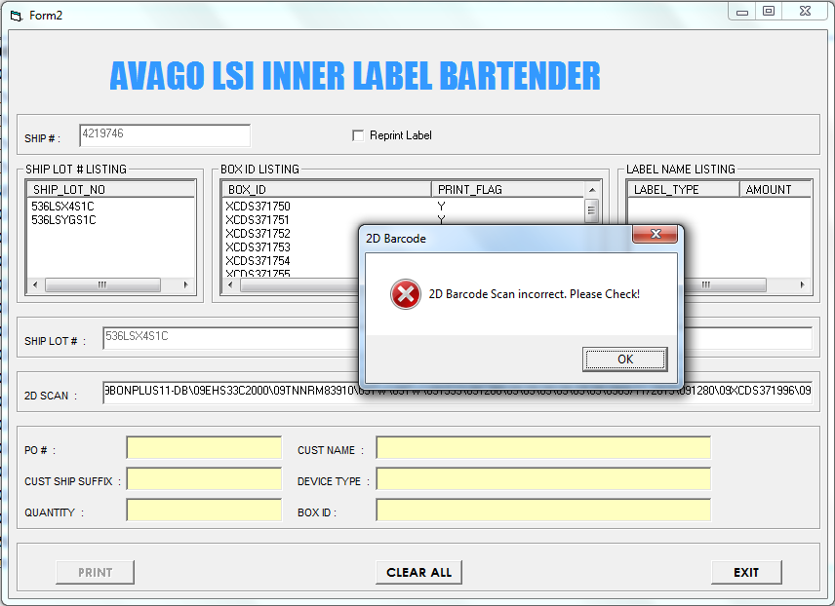
2D Barcode No/Scan Invalid

Slide 19
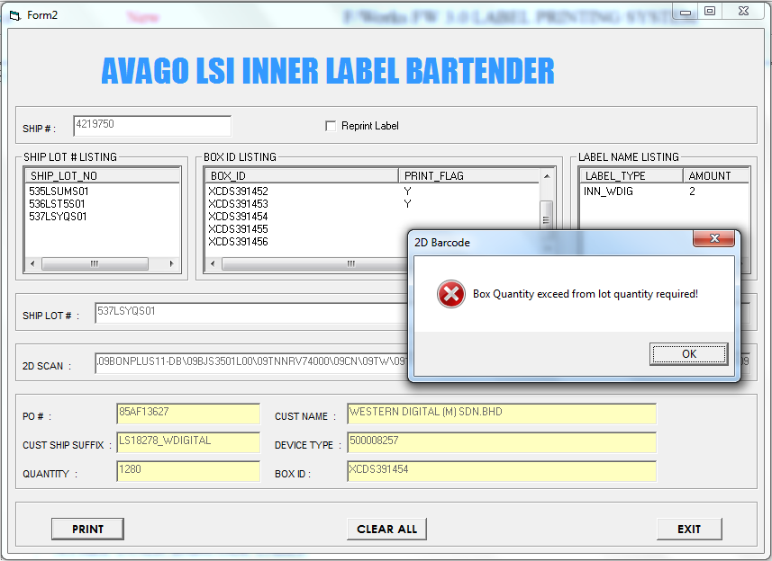
Print Quantity Exceed from Request Quantity

Slide 20
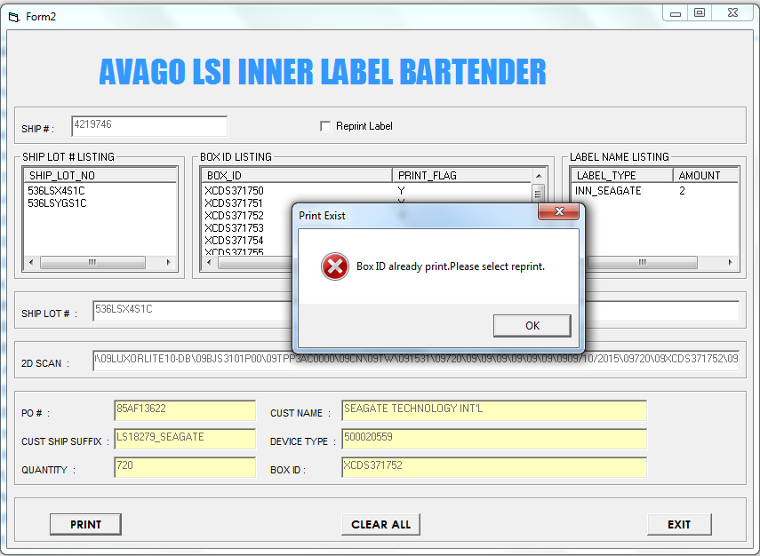
Reprint Label Function Not Select for Reprint Label

Slide 21
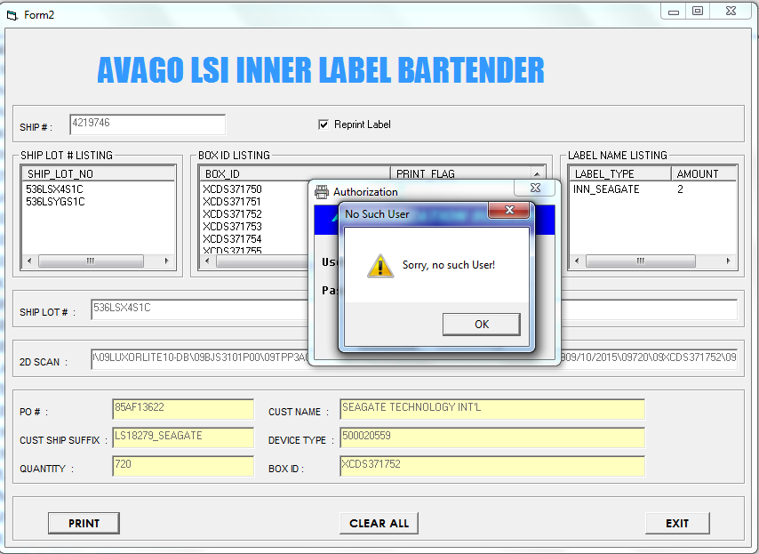
Reprint Not Authorize Person

Slide 22
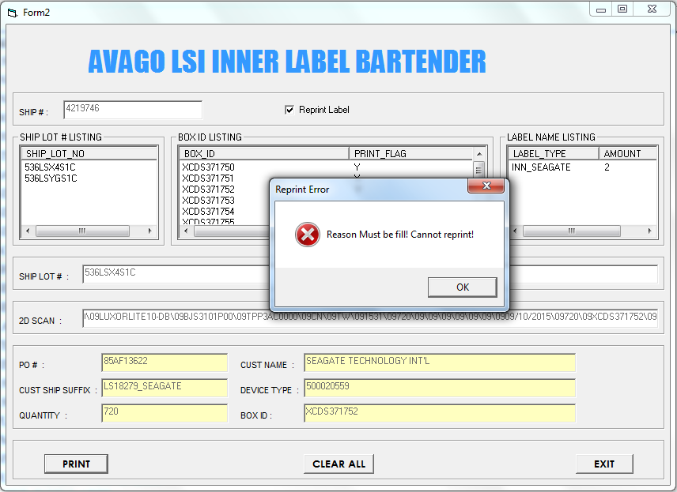
Reprint Reason Not Fill

Slide 23

Label File Not Found

Slide 24
END

